Slide 1
Topic: Substitution EQ: When do we use substitution in trigonometry?
In algebra, substitution means replacing a letter with a number
REMEMBER: A number and a letter next to each other mean they are multiplying each other
E.g. 3a means 3 x a.

Slide 2
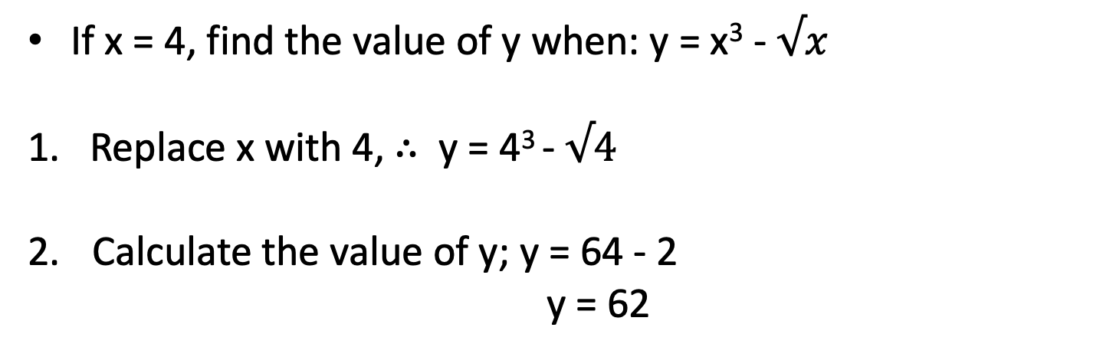
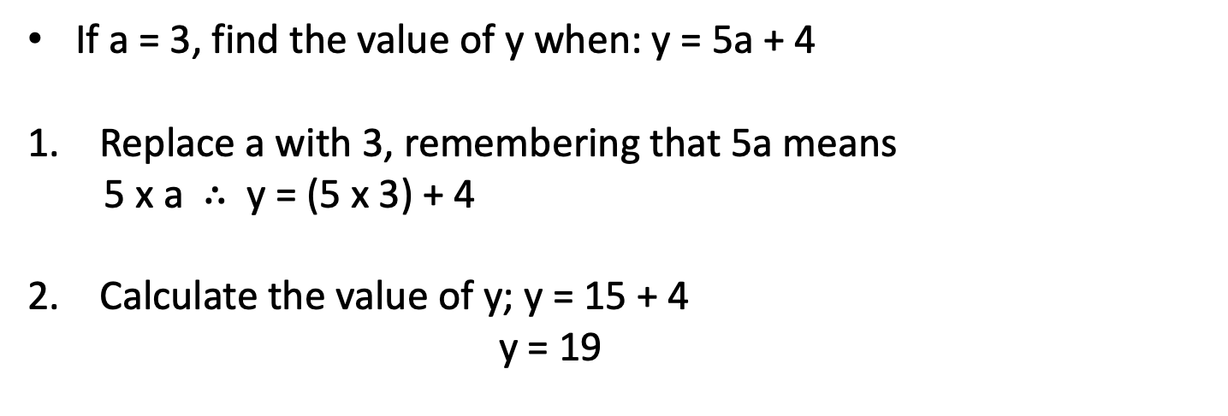
Topic: Substitution EQ: When do we use substitution in trigonometry?
If a = 3, find the value of y when: y = 5a + 4
Replace a with 3, remembering that 5a means
5 x a $∴$ y = (5 x 3) + 4
Calculate the value of y; y = 15 + 4
y = 19
If x = 4, find the value of y when: y = x³ - $√x$
1. Replace x with 4, $∴$ y = 4³ - $√4$
Calculate the value of y; y = 64 - 2
y = 62

Slide 3
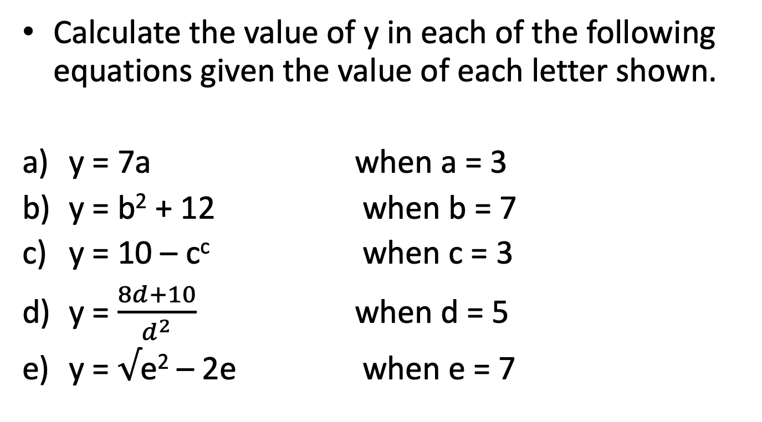
Topic: Substitution EQ: When do we use substitution in trigonometry?
Calculate the value of y in each of the following equations given the value of each letter shown.
y = 7a when a = 3
y = b² + 12 when b = 7
y = 10 – c^{c} when c = 3
y = $\frac{8d+10}{d^{2}}$ when d = 5
y = $√$e² – 2e when e = 7
y = 21
y = 61
y = -17
y = 2
y = -7

Slide 4
Topic: Substitution EQ: When do we use substitution in trigonometry?
Use substitution to evaluate the following:
y = 3c – 5 when c = 9
y = 3r - 10 when r = 3
y = f² + 7 when f = 5
y = 7x when x = 10
y = 12w + 12 when w = 6
y = a – 4 when a = -2
y = B – 8 when B = 3
y = 13 + b when b = 7
y = 8t + 11 when t = 4
y = 2Q – 9 when Q = 8

Slide 5
Topic: Substitution EQ: When do we use substitution in trigonometry?
Complete Substitution Worksheets 1 and 2

